Slide 1
2026 Capital Projects in MacTier
MacTier Ball Park - Backstop fence, infield material $40,000
Playground $100,000
MacTier Cemetary - upgrades and software $30,000
Dog Park $20,000
Front Street Lighting $180,000
Front Street Sidewalk $125,000
Arena Digital Sign Board $15,000
Fuel Tank Operations Yard $11,800
North Operations Yard $28,400
North Yard Dome $15,800
MacTier Cemetery Building $1,700
MacTier Fire Station 2 $7,400
MacTier Memorial Arena $346,600
TOTAL $921,700
This represents 63% of the total capital expenditure across the whole Township, excluding roads and fleet.
Longer Term Capital Investments
Over the next 15 years it will cost the Township $17.8M to maintain all of its existing facilities with no additional upgrades – or $1.2M per year, on average.
MacTier would receive $8M, representing 45% of Township facility capital costs – or $533,000 per year, on average. $6M out of the $8M is allocated to the Arena facility.
This investment will have to be partially supported through tax increases.

Slide 2
2026 Capital Projects in MacTier
Project | Cost ($) | Cost (%)
MacTier Memorial Arena | 346,600 | 38%
Front Street Lighting | 180,000 | 20%
Front Street Sidewalk | 125,000 | 14%
Playground | 100,000 | 11%
MacTier Ball Park - Backstop fence, infield material | 40,000 | 4%
MacTier Cemetary - upgrades and software | 30,000 | 3%
North Operations Yard | 28,400 | 3%
Dog Park | 20,000 | 2%
North Yard Dome | 15,800 | 2%
Arena Digital Sign Board | 15,000 | 2%
Fuel Tank Operations Yard | 11,800 | 1%
MacTier Fire Station 2 | 7,400 | 1%
MacTier Cemetery Building | 1,700 | 0%
Total | 921,700 | 100%
63% of the total capital expenditures across the whole Township, are taking place in MacTier, excluding roads and fleet.

Slide 3
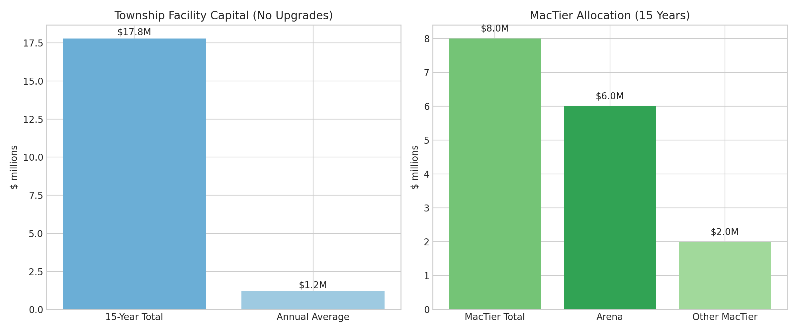
Long Term Capital Investments
Over the next 15 years, it will cost the Township $17.8 million to maintain all existing facilities with no additional upgrades. This represents an average annual cost of $1.2 million. The MacTier community accounts for $8 million of these projected costs, or 45% of all Township facility capital expenditures, equivalent to approximately $533,000 per year on average. Of the MacTier total, $6 million is allocated to the Arena facility alone. Meeting these investment requirements will necessitate tax-supported funding, meaning a portion of these costs will need to be accommodated through future tax increases.

Slide 4
MacTier Arena: By the Numbers
Built in 1977 – 49 years old
Replacement cost – around $18M
Capital costs over the next 15 years – around $6M
Average annual capital cost – around $390,000 to maintain status quo
Annual cost to operate – around $250,000
Total annual cost to keep Arena “as is” – around $640,000 ($390+$250)
Revenue generated through user fees – around $37,000 per year

